Slide 1
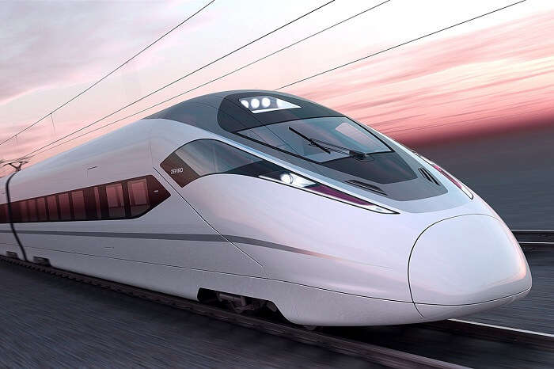
G.B HOUSE
G.B. EQUIPMENT SYSTEM LTD.
MANUFACTURER OF HYDRAULIC DAMPERS FOR INDIAN RAILWAYS
Prepared By
Situn Rout

Slide 2
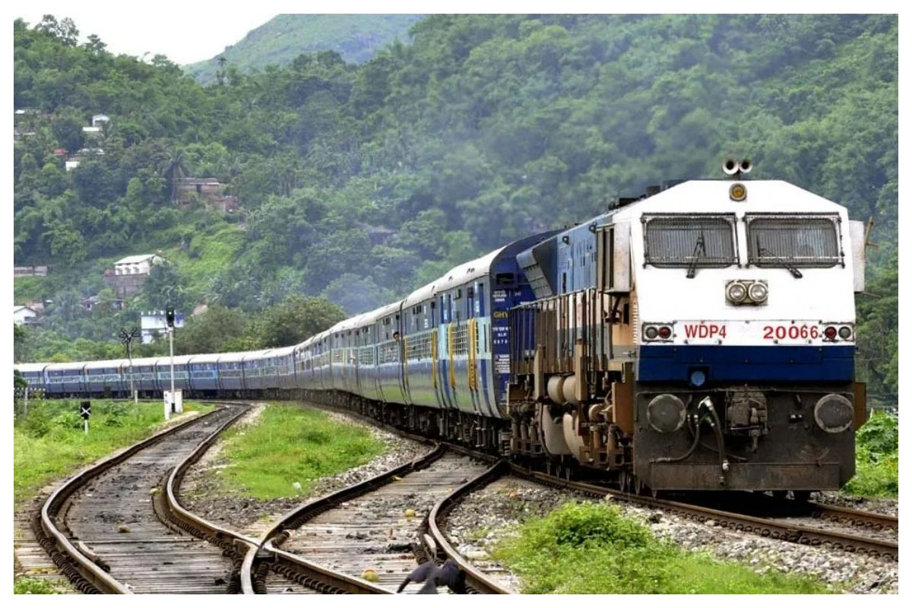
Trusted Partner
G.B Equipment System Limited proud of serving the nation as a supplier to Indian Railways
Which caters to public mass transportation system. Indian Railways ranks fourth as the largest
Network in the world . For G.B Equipment ,Railway Business started way back in 2017 at
Chhotarampur ,Dehradun,uttarakhand .

Slide 3
G.B Equipment in Indian Railway (OEM’s)
Rail Coach Factory(RCF- Kapurthala)
Integral Coach Factory (ICF-Chennai)
Modern Coach Factory (MCF- Raebareli)
Kolkata Metro
Narrow Gauge
Chittaranjan Locomotive Works (CLW-West Bengal)
Patiala Locomotive Works (PLW-Punjab)
Banaras Locomotive Works (BLW-Banaras)
Other Zonal Railways
Railways Aftermarket
Thailand Railways

Slide 4
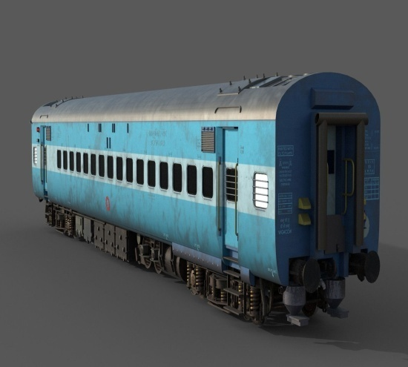
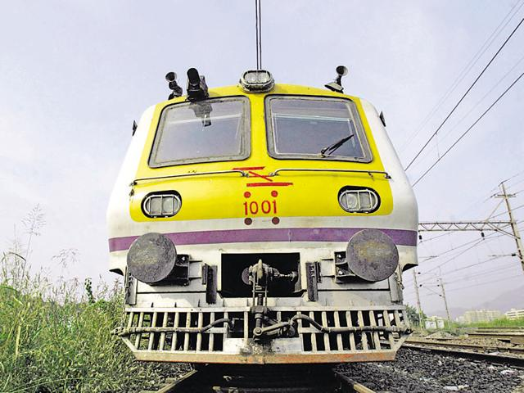
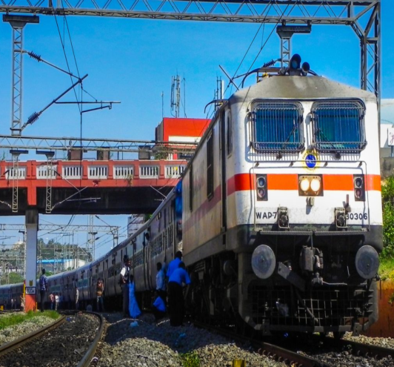
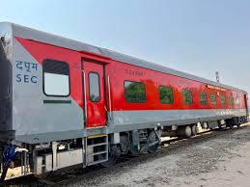
Presence Across Railway Vertical
ICF COACH
EMU COACH
LOCOMOTIVES
LHB COACH

Slide 5
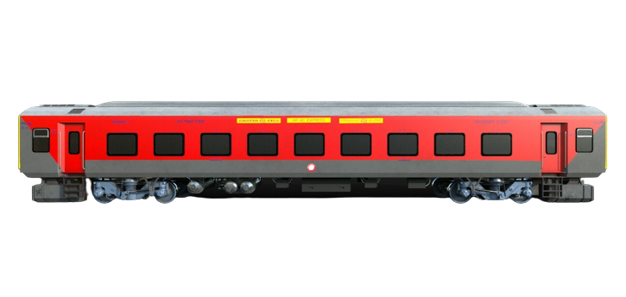
LHB COACH
LHB stands for LINKE HOFMANN BUSCH. It is a Railway Coach Manufacturing unit Situated at Germany. The coaches Manufactured by LHG/Germany are called LHB coaches.
These coaches are now being manufactured at RCF/ Kapurthala after getting the transfer of technology from GERMANY.

Slide 6
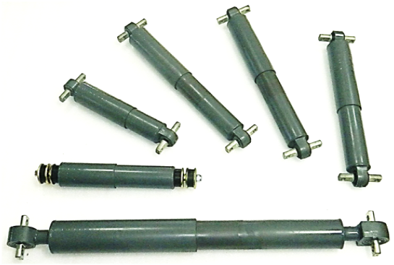
Special Features of LHB Dampers
G.B Equipment Dampers are designed for various rail applications depending on damping force requirements & Mounting end types. G.B Equipment dampers are easily serviceable at overhauling interval & lower maintenance cost . We offer a complete overhauling kit along with reconditioning method specified in manual for case of understanding.
Indigenous Serviceable Design
Ends Silent Block/ Rubber Bushes Mounting.
Instantaneous Response to Smaller amplitude.
High Corrosion Resistance
Stable Damping Characteristics
Higher Durability Life
Operating Temperature Range -20 ˚C to 80 ˚C .
Easy for Overhauling

Slide 7

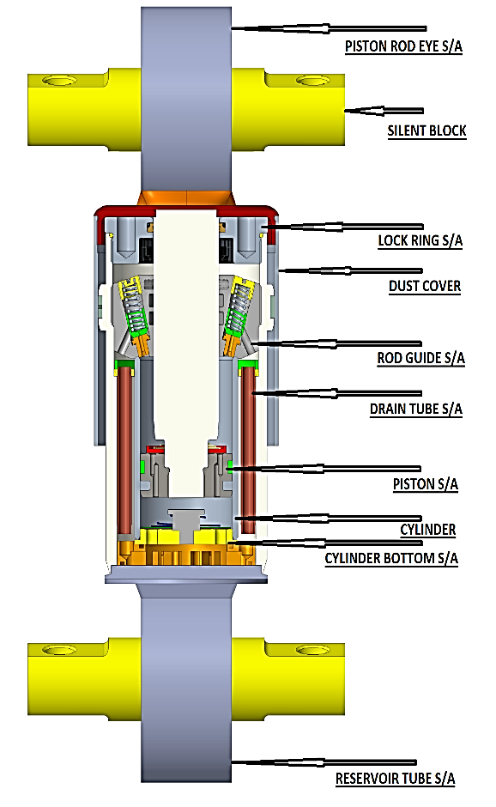
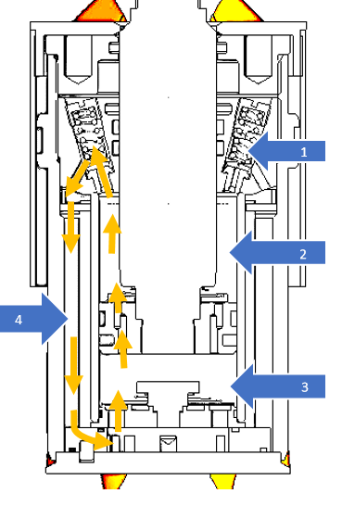
G.B. EQUIPMENT SYSTEMS LTD.
Manufacturer of Railway Equipment's
WORKING PRINCIPLE OF HYDRAULIC DAMPER:
This damper type has a circulating oil flow or mono flow principle.
In extension stroke the non-return valve in the piston is closed and the oil above the piston is forced through the damping valves into the reservoir tube. At the same time, because of the increased volume below the piston, oil is forced through the non-return cylinder bottom valve.
In compression stroke the non-return cylinder bottom valve is closed and because the piston is forced down in the cylinder, oil flows through the now open non-return valve in the piston. The oil displaced by the piston rod is forced through the damping valves. Therefore, during the compression stroke the oil pressures above and below the piston are equal.
1. Valving Arrangement
2. Top Chamber
3. Bottom Chamber
4. Oil Chamber

Slide 8
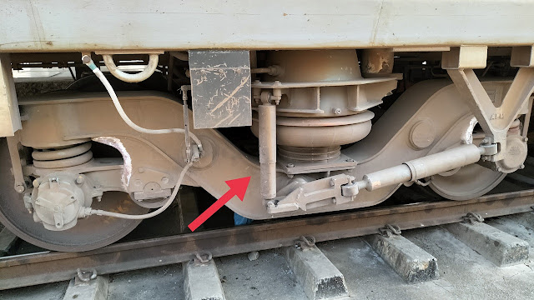
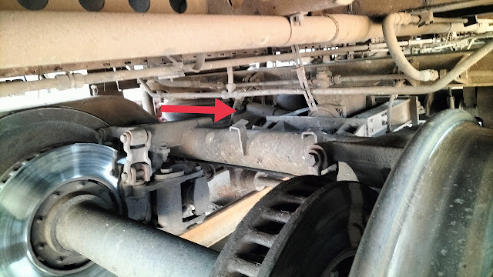
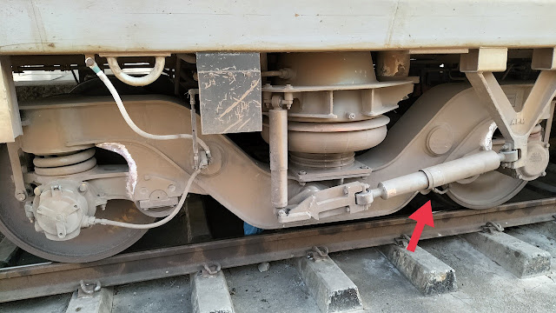
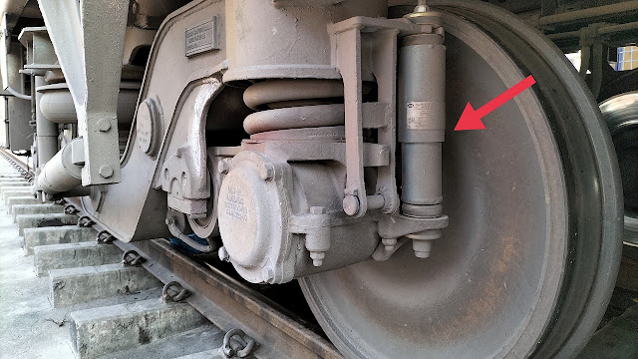
HOW MANY DAMPERS IN LHB COACH
Dampers are very essential part of a vehicle to make journey jerk free.
In LHB coaches there are a total of 18 Dampers per coach, and a total of
9 dampers per Bogie.
TYPE OF DAMPER | NO OF DAMPERS
Primary Vertical | 8
Secondary Vertical | 4
Anti Yaw | 4
Secondary Lateral | 2
Total Dampers | 18
SECONDARY VERTICAL DAMPER
SECONDARY LATERAL DAMPER
ANTI YAW DAMPER
PRAIMARY VERTICAL DAMPER

Slide 9
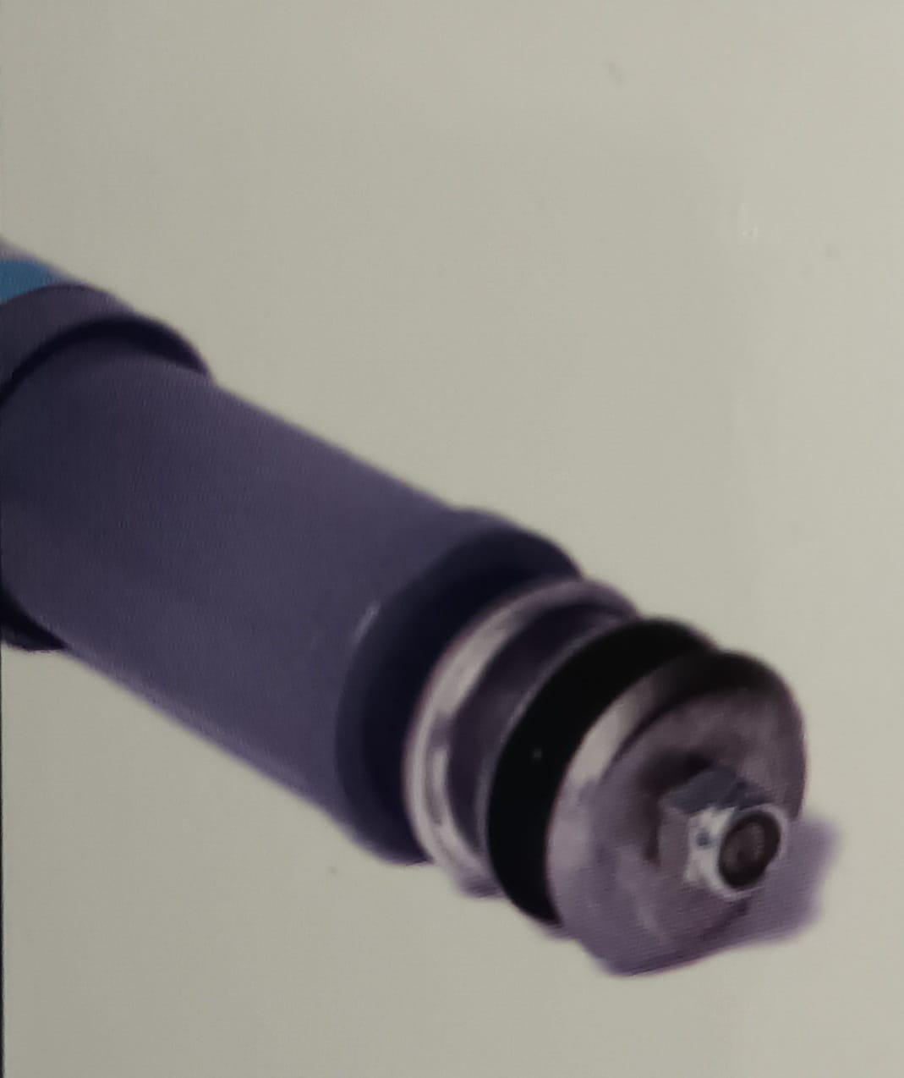
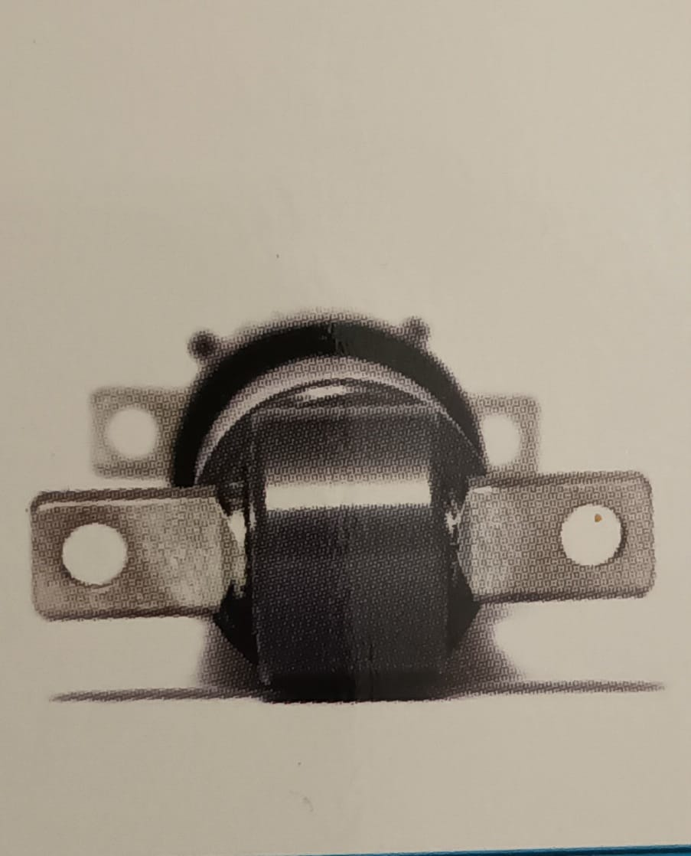
Technical Characteristics
End Mounting Types
Rubber Bush Type
Silent Block Type
Damping force range
Dimensional Range for
Dampers (Fitment Lengths)
100kg to 1567kg @0.1m/sec velocity.
434kg to 2041kg @0.3m/sec velocity.
Extended Length 385mm to 1083mm.
Low speed (0.01m/s) with higher damping force values.
Collapsed Length 294mm to 703mm.
Multi speed damping characteristics.

Slide 10
Technical Requirement of Dampers
TECHNICAL REQUIREMENT OF DAMPERS
 | PARAMETERS
DAMPER TYPE | Drawing No. | Compressed Length (mm) | Extend Length (mm) | Testing height (mm) | Stroke (mm) | Velocity (m/sec) | Force (N)
PRIMARY VERTICAL | LW05102 | 294±3 | 434±3 | 365 | 50 | 0.3 | 4250±640
SECONDARY VERTICAL (AC) | LW05101 | 395±3 | 635±3 | 515 | 50 | 0.2 | 3500±520
SECONDARY VERTICAL(N-AC) | LG05102 | 395±3 | 635±3 | 515 | 50 | 0.1 | 4000±600
SECONDARY LATERAL | LW05100 | 395±3 | 635±3 | 515 | 50 | 0.3 | 8000±1200
AIR SPRING DAMPER | LW05122 | 360±3 | 545±3 | 450 | 50 | 0.3 | 8000±1200
ANTI YAW | LW05103 | 703±3 | 1083±3 | 890 | 50 | 0.1 | 11000±1650
1. The nominal test temperature of the damper is 20±3˚
2. The construction of Hydraulic damper shall be withstand the static compressive axial load of 3 tones when fully closed & fully extend.
3. Damper should be function safely at extreme temperature in range of -10˚ to 70˚ C.
4. Force Displacement graph shall be free from :
Flux
Local vibration phenomena
Jumps & sudden change in shape of the curve .
5. Damper mounting arrangement will be design to withstand vibration / heavy instantaneous shock.

